Slide 1
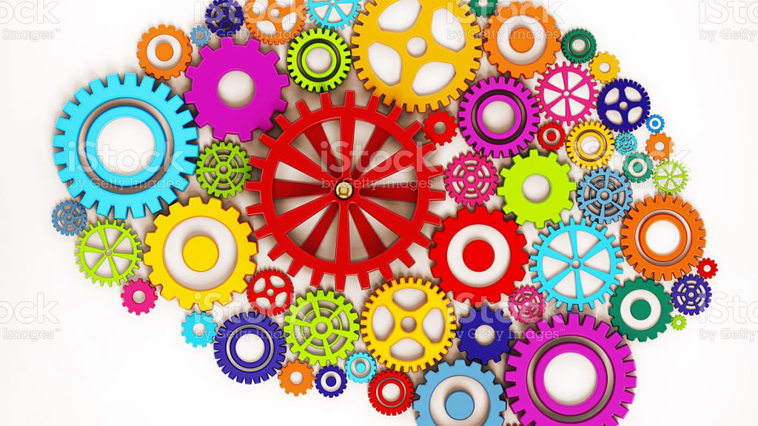
Social Perception and Cognition

Slide 2

Introduction
Schemas
Implicit Personality Theory
Impression Formation
Attribution Theory - Bias and Error in Attribution

Slide 3
Social Perception and Cognition
Social Perception
“Constructing an understanding of the social world from the data we get through our senses…the processes by which we form impressions of other people’s traits and personalities”
Attribution
“we observe others’ behaviour and then infer backward to causes…that explain why people act as they do”

Slide 4
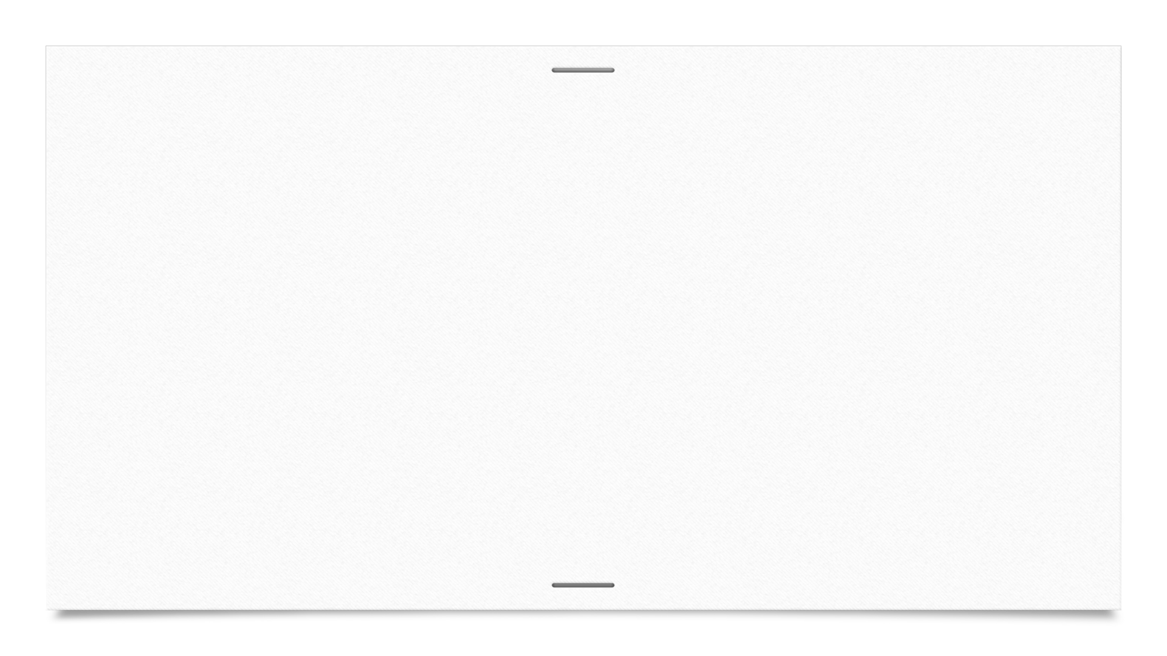
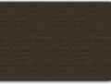
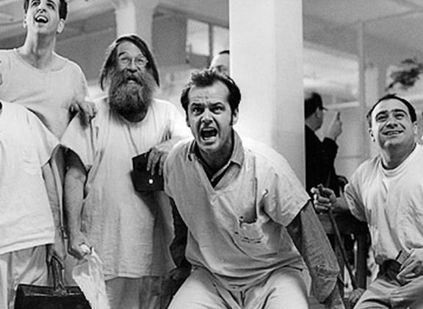
Rosenhan Experiment
‘On Being Sane in Insane Places’ 1973
Pseudo-Patients Entering Psychiatric Hospitals with ‘Schizophrenic’ Symptoms
Acted Normal Once Admitted

Slide 5
Quote from Rosenhan’s Findings
“Despite their public "show" of sanity, the pseudopatients were never detected. Admitted, except in one case, with a diagnosis of schizophrenia, each was discharged with a diagnosis of schizophrenia "in remission." The label "in remission" should in no way be dismissed as a formality, for at no time during any hospitalization had any question been raised about any pseudopatient's simulation. Nor are there any indications in the hospital records that the pseudopatient's status was suspect. Rather, the evidence is strong that, once labeled schizophrenic, the pseudopatient was stuck with that label. If the pseudopatient was to be discharged, he must naturally be "in remission"; but he was not sane, nor, in the institution's view, had he ever been sane.”

Slide 6
So What?
What does this say about social perception and attribution?
Staff used their surroundings and cognitive structure to understand these people as insane
The staff didn’t expect to meet researchers – they expected to meet mentally ill people

Slide 7
Schemas
What is a Schema?
A cognitive framework that helps us to organize and interpret information
Our Schemas don’t have to be the same but may share common characteristics
Help us to organize and remember facts, to make inferences, and assess new information

Slide 8
Categorization
Tendency to understand phenomena as Categories – as part of groups – rather than unique entities
Prototype
The most typical instance of a category
Often made up of a set of common attributes

Slide 9

Different Types of Schemas
Person Schemas
Self-Schemas
Group Schemas
‘Stereotypes’
Role Schemas
Event Schemas
‘Scripts

Slide 10
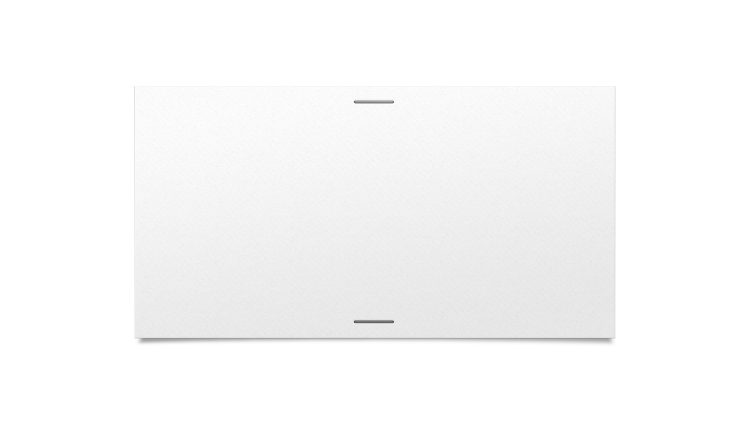
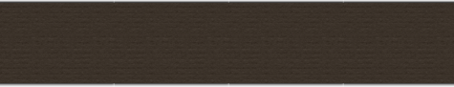
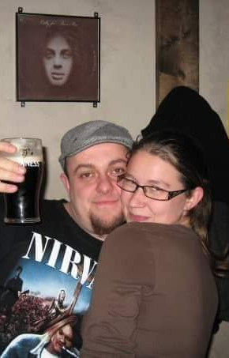
Person Schema

Slide 11
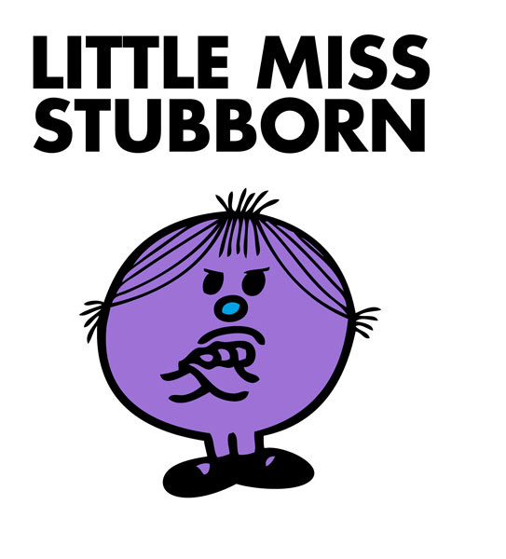
Self-Schema

Slide 12
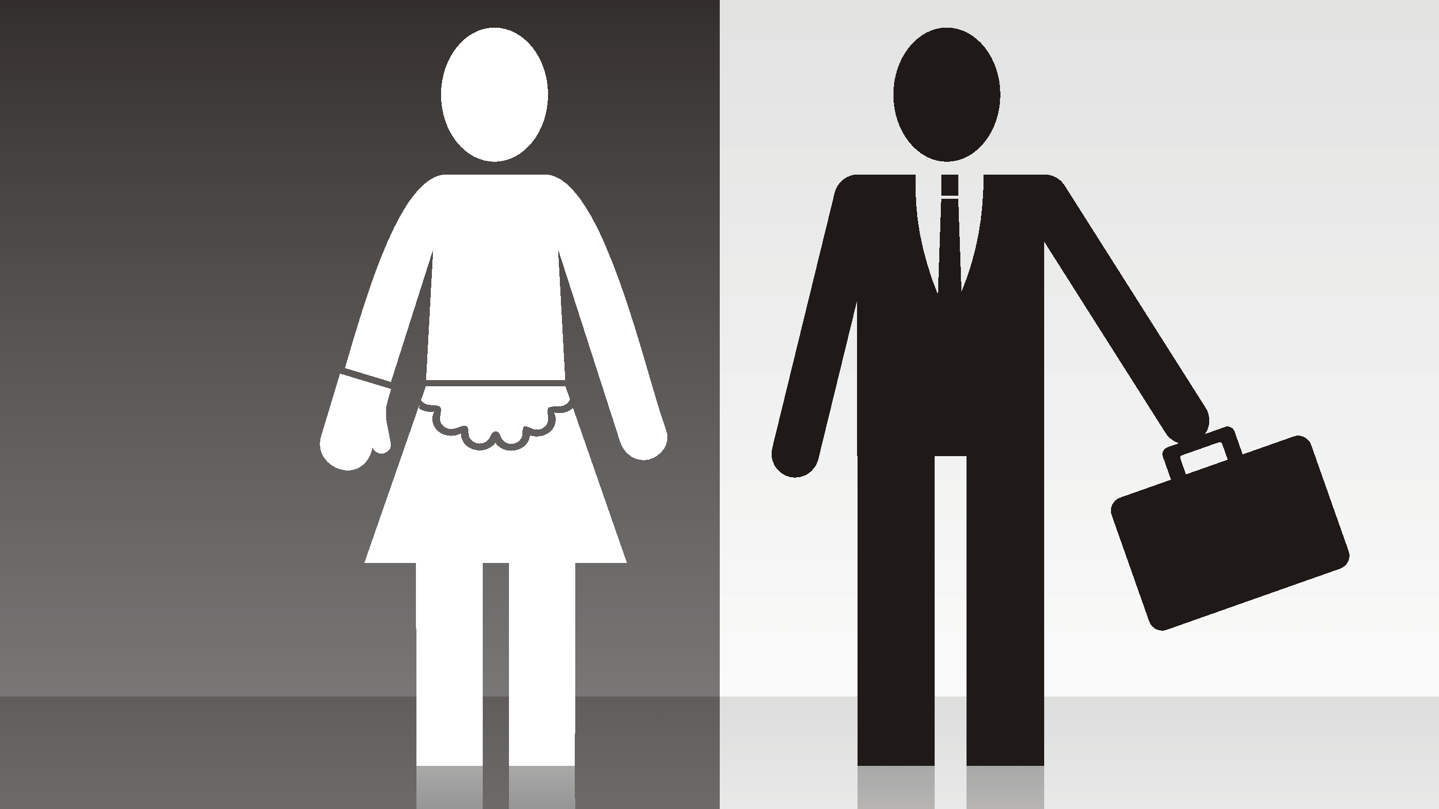
Group Schemas

Slide 13
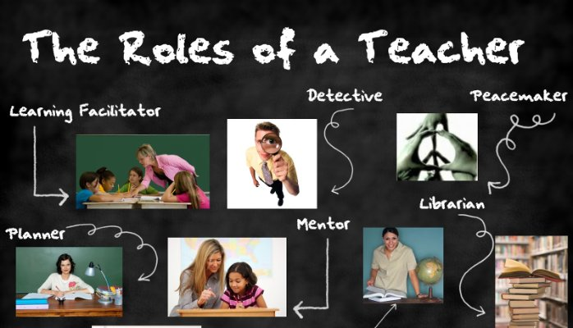
Role Schemas

Slide 14

Event Schemas

Slide 15
Why Do We Use Schemas?
Help Us to Organize and Understand our Complex World
Help us to Focus on What is Important
Help us to recall more salient/relevant facts
Help us to process information faster
Help to guide our inferences
Reduce ambiguity

Slide 16
Disadvantages
More Accepting of Information that Fits into Current Schema
Fill in Missing Information that Fit into Pre-Existing Schemas
Reluctant to Change Schemas

Slide 17
Implicit Personality Theory
The Inference of Co-occurrence of Personality Traits Based on Another Personality Trait
The Halo Effect

Slide 18

Implications of IPT
Can Lead to Poor Judgement

Slide 19
Impression Formation
Process of Creating a Coherent Picture of Someone Based on Many Sources of Information
Trait Centrality
Self-Fulfilling Prophecy
Heuristics

Slide 20
Trait Centrality
Certain Traits Ranking High in Our Perception of a Person
Impacts Overall Impression
Also impacts how we perceive the other traits associated with the individual

Slide 21
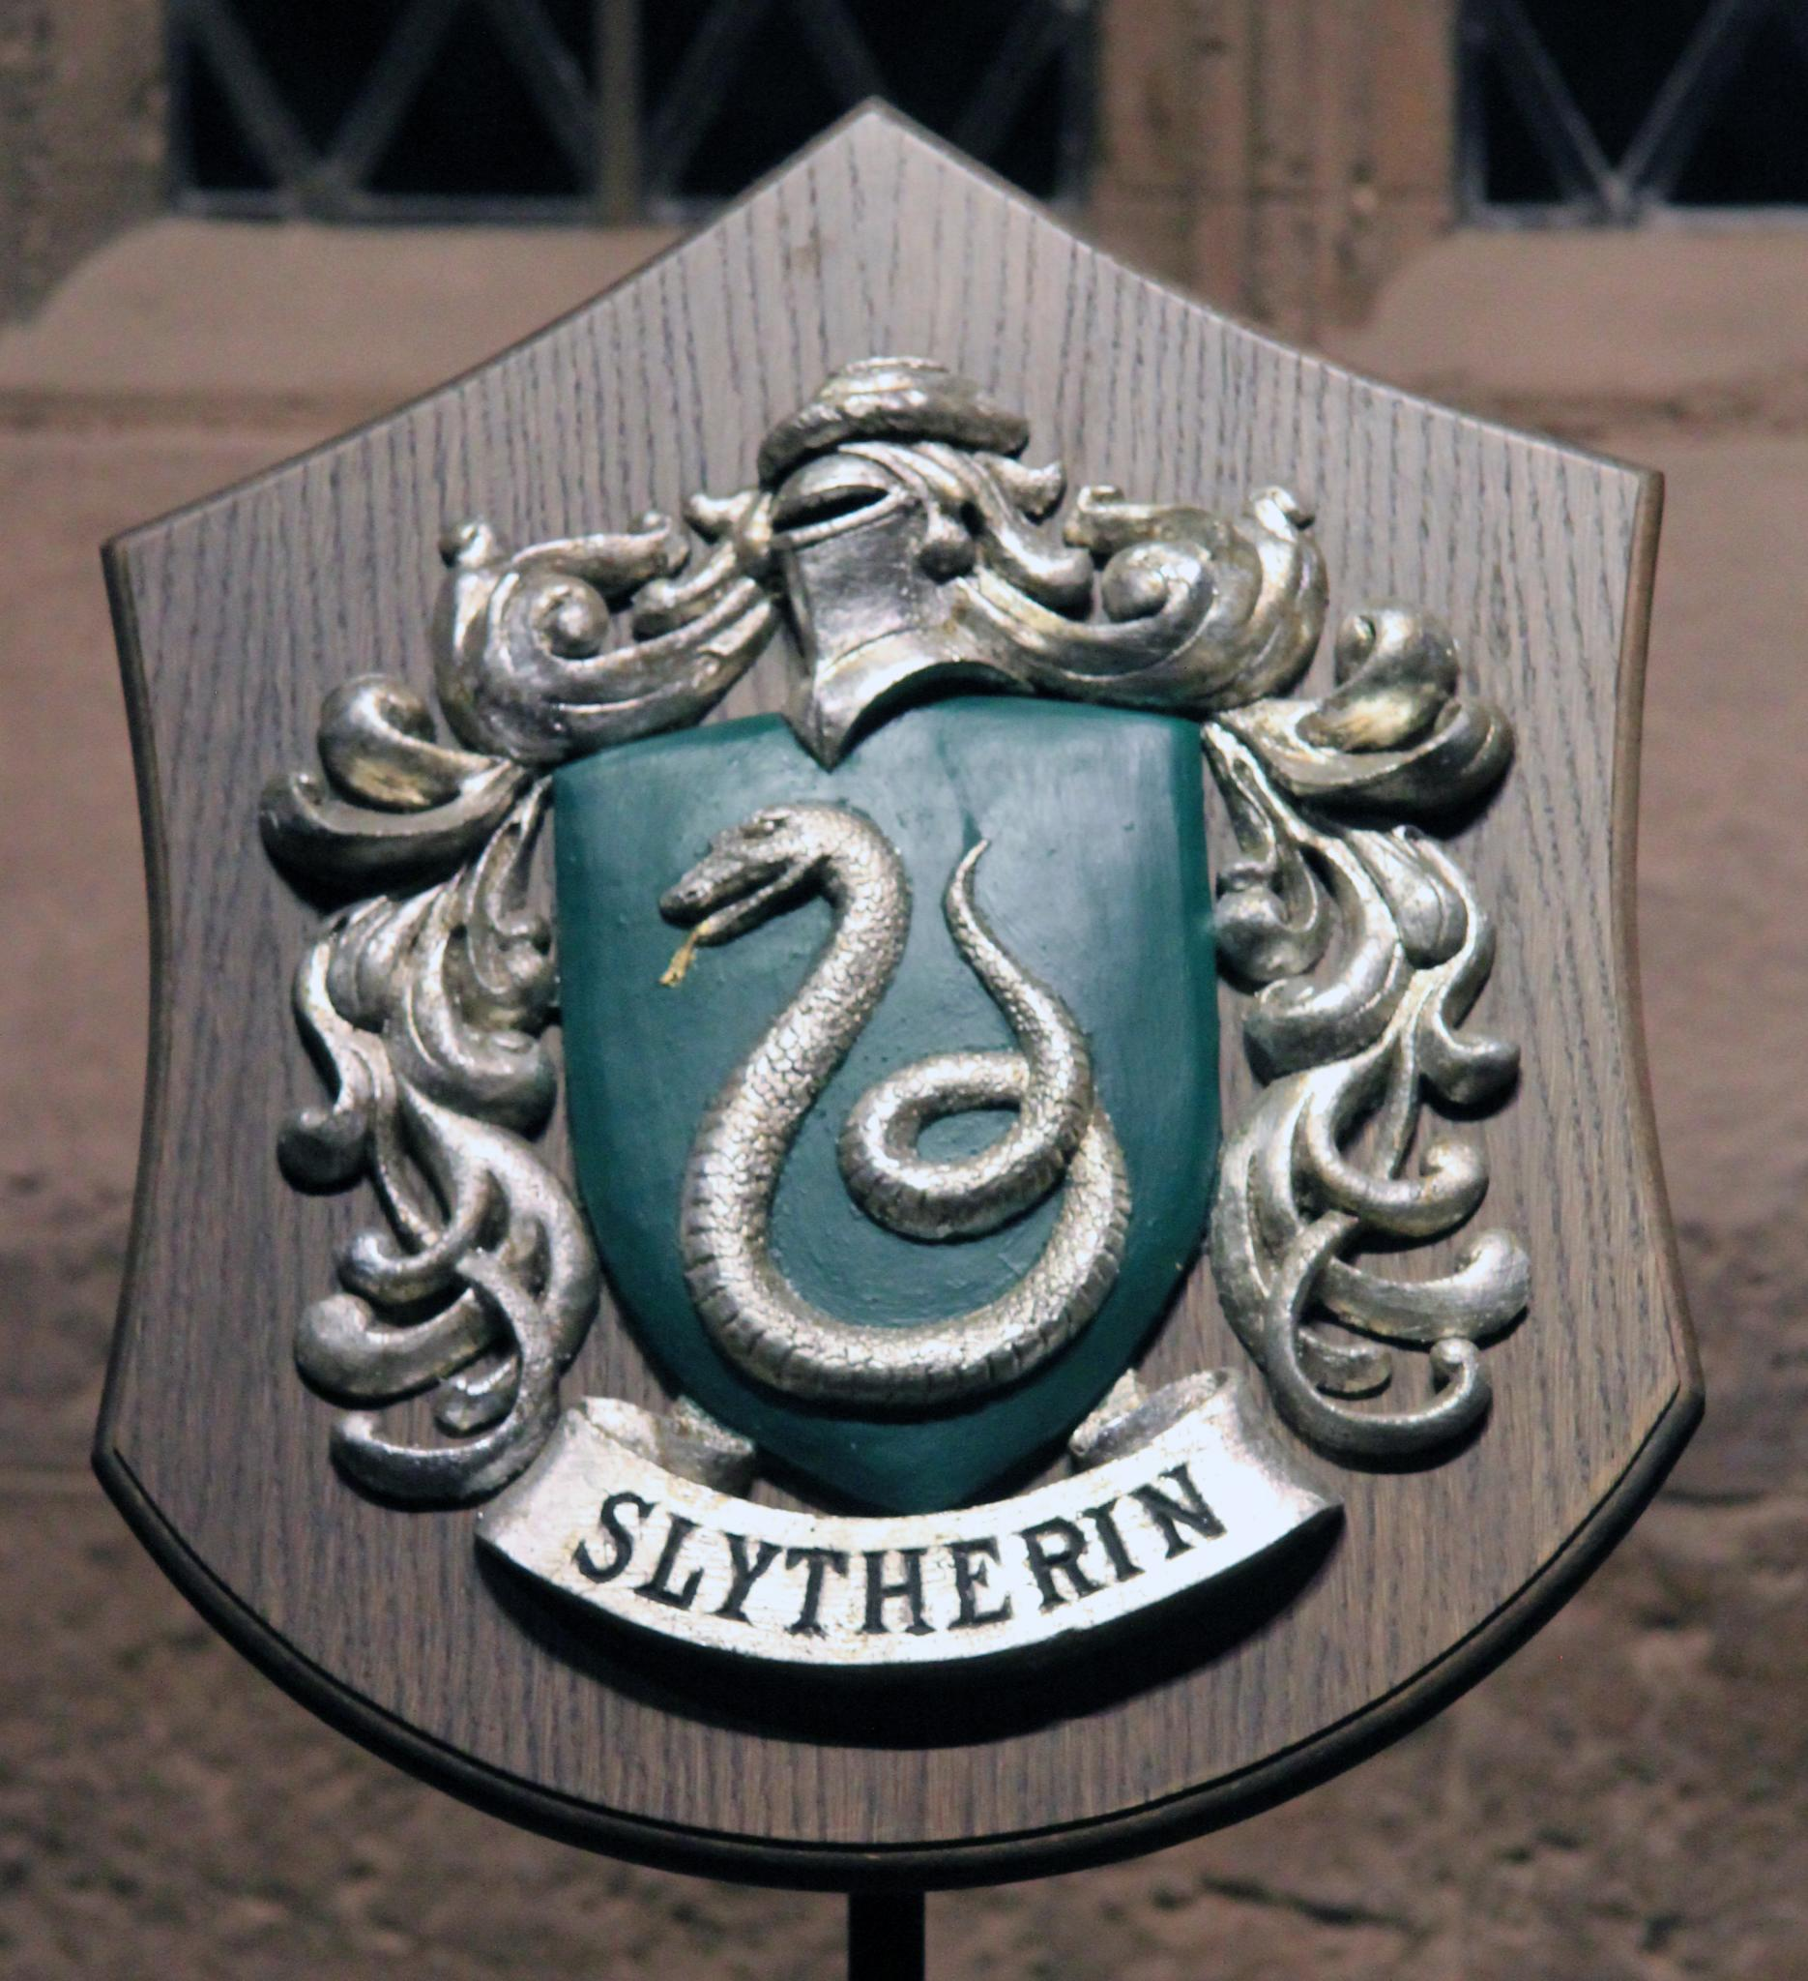
Self-Fulfilling Prophecies
When we act towards someone based on our impression of them and they reflect that impression back to us
They react in ways that confirm our original impression

Slide 22
Heuristics
A Mental Short-Cut That Helps Us Choose that Appropriate Schema
Availability
Representativeness

Slide 23
Attribution Theory
The Process We Use to Infer the Causes of Someone’s Behaviour
In doing so, we are able to act effectively in the situation and make inferences about their future actions or behaviours

Slide 24
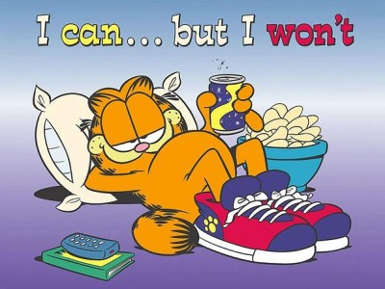
Attribution Theory
Dispositional Attribution
Internal Characteristics
Situational Attribution
Environmental Factors

Slide 25
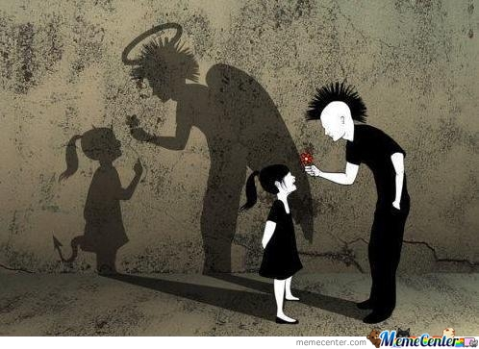
Bias and Error in Attribution

Slide 26
Fundamental Attribution Error
FAE
“the tendency to overestimate the importance of personal (dispositional) factors and underestimate situational influences”

Slide 27
Focus-of-Attention Bias
Focusing on certain aspects of the person or situation, we may ignore other influencing factors

Slide 28
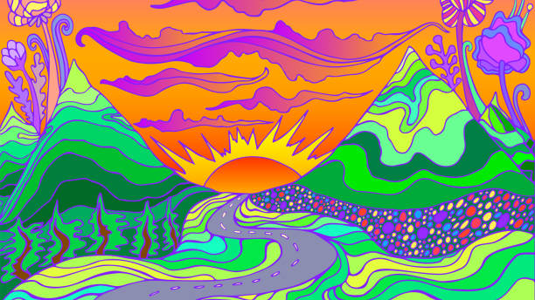
Have a Great Day!

